Slide 1
Map Interface When do we need it?
Khaliunaa Baasandorj

Slide 2
Outline
What is Map Interface?
How to access its data?
When do we need it?

Slide 3
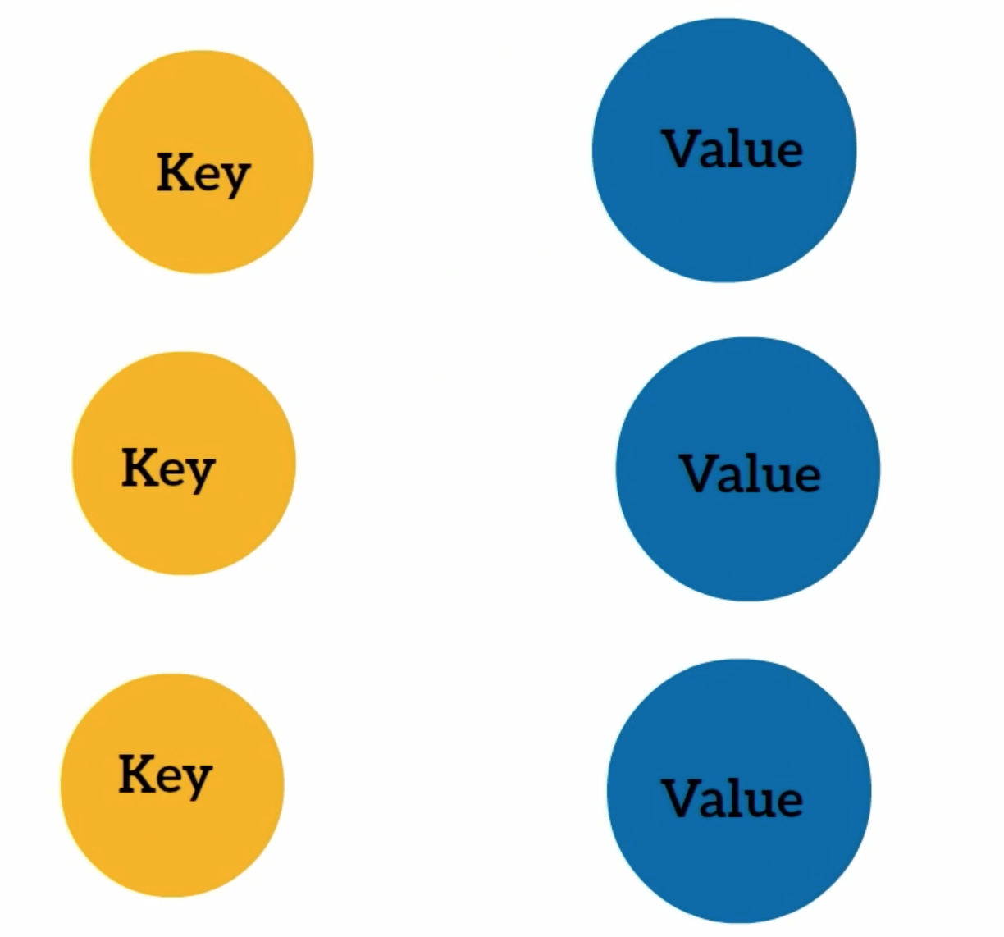
What is Map Interface?

Slide 4
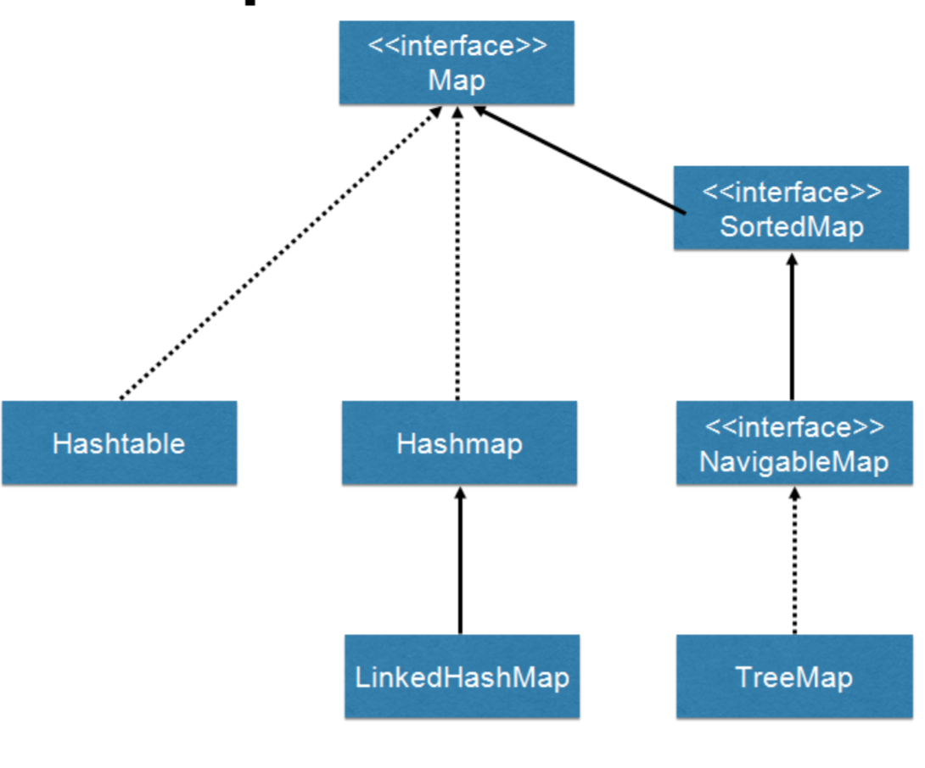
What is Map Interface?

Slide 5
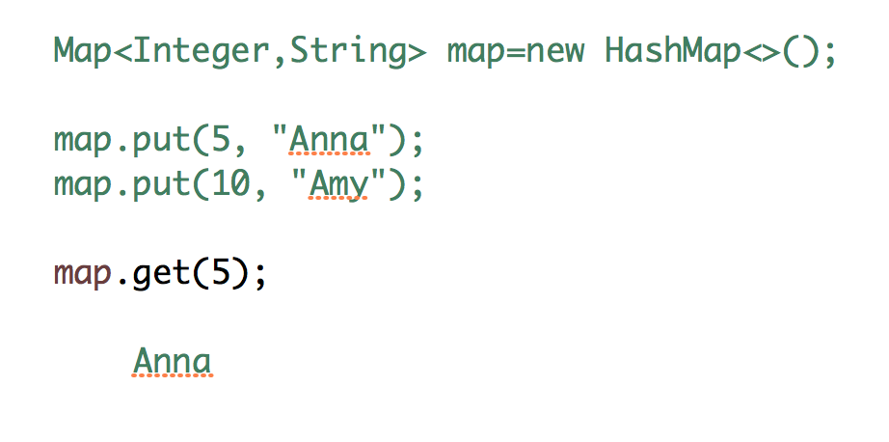
How to access its data 1

Slide 6
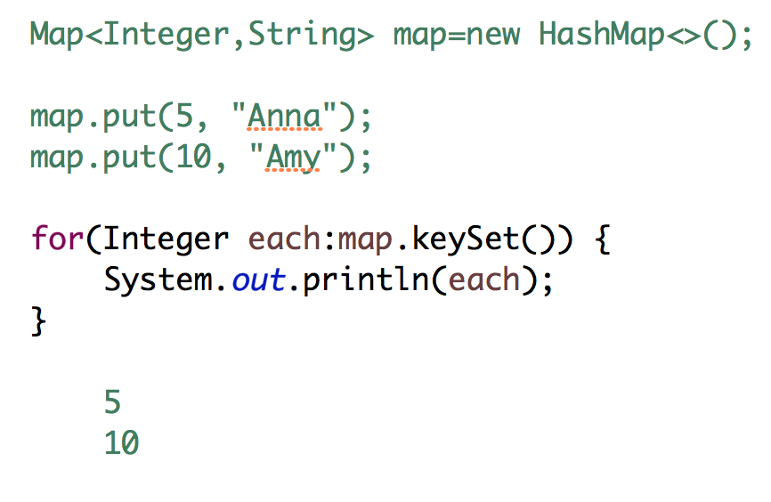
How to access its data 2

Slide 7
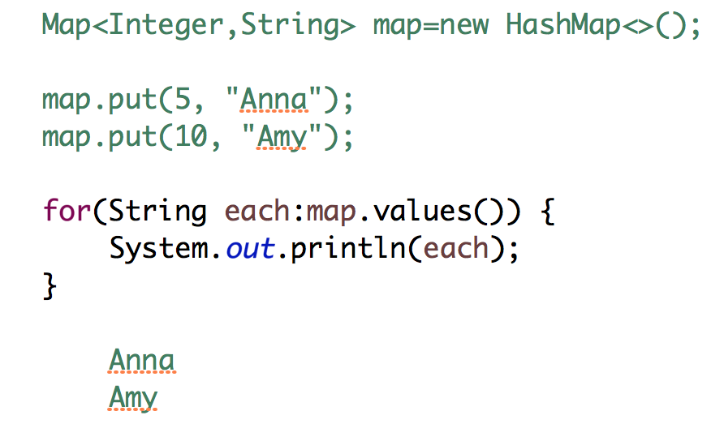
How to access its data 3

Slide 8
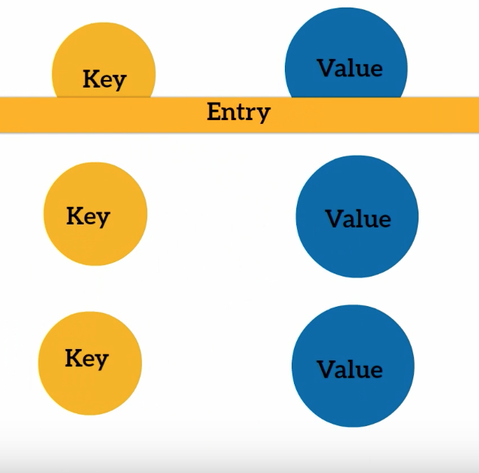

Slide 9
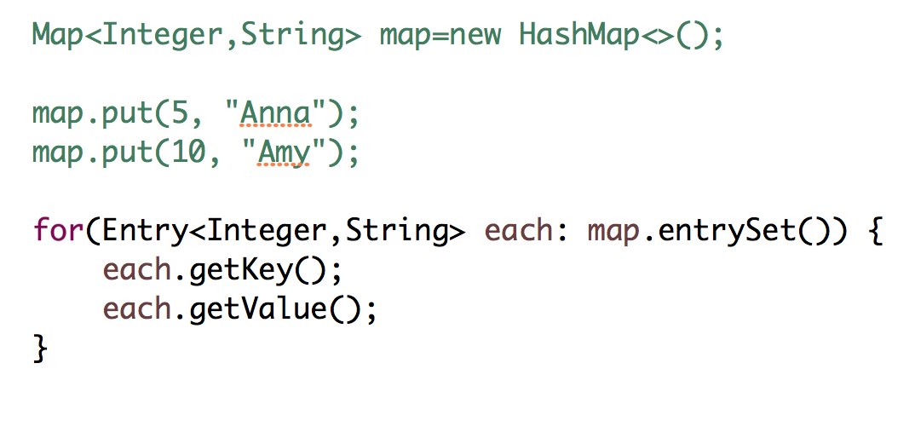
How to access its data 2

Slide 10
When do we need Map?

Slide 11
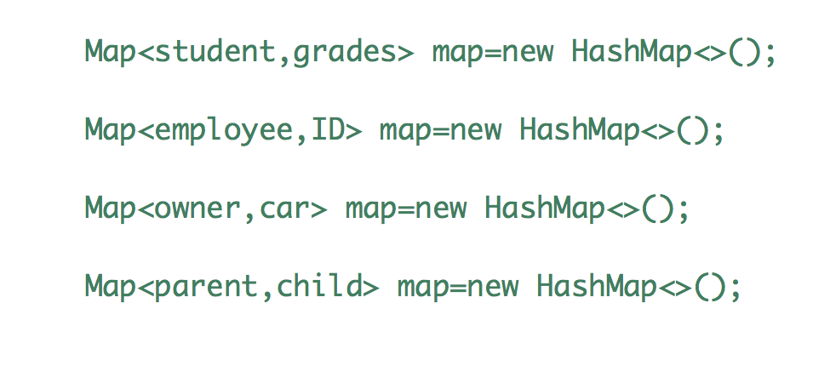

Slide 12
